Slide 1


<Jessie>
<26 Jan 2023>

Slide 2

Outline
Executive Summary
Introduction
Methodology
Results
Conclusion
Appendix

Slide 3
Executive Summary
Summary of methodologies
Web scraping, Web wrangling, Standarisation, Classification Model (Logistic Regression, Decision Tree, KNN, SVM)
Summary of all results
The accuracy is around 85%.

Slide 4
Introduction
Project background and context
Many people wants to travel space and many companies tries to catch this business opportunities. SpaceX is the most successful among these companies. SpaceX can send spacecraft to the International Space Station. The reason why SpaceX is so popular is that the first stage can be reuse and the price is relatively low.
Problems you want to find answers
We needs to determine whether the first stage will land and therefore we can estimate the cost of the trip.

Slide 5

Section 1

Slide 6
Methodology
Executive Summary
Data collection methodology:
Web scraping
Perform data wrangling
Calculate the number of launches on each site, Calculate the number and occurrence of each orbit, Calculate the number and occurrence of mission outcome per orbit type, Create a landing outcome label from Outcome column
Perform exploratory data analysis (EDA) using visualization and SQL
Perform interactive visual analytics using Folium and Plotly Dash
Perform predictive analysis using classification models
How to build, tune, evaluate classification models

Slide 7
Data Collection
Describe how data sets were collected.
Data sets are collected from SpaceX API and using web scraping.
You need to present your data collection process use key phrases and flowcharts

Slide 8
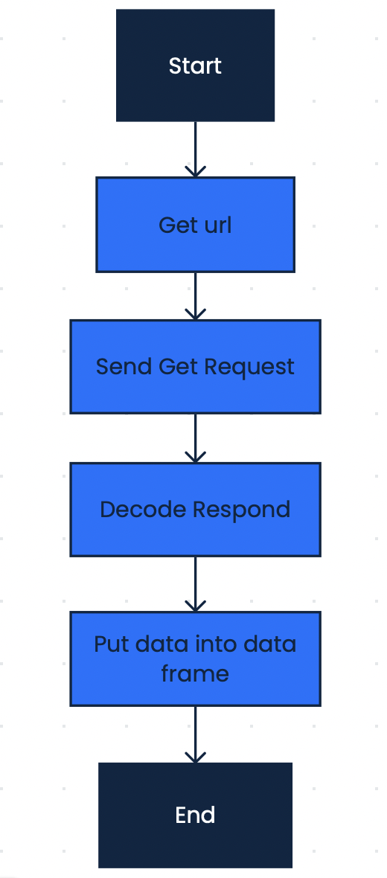
Data Collection – SpaceX API
Present your data collection with SpaceX REST calls using key phrases and flowcharts
Add the GitHub URL of the completed SpaceX API calls notebook (must include completed code cell and outcome cell), as an external reference and peer-review purpose

Slide 9
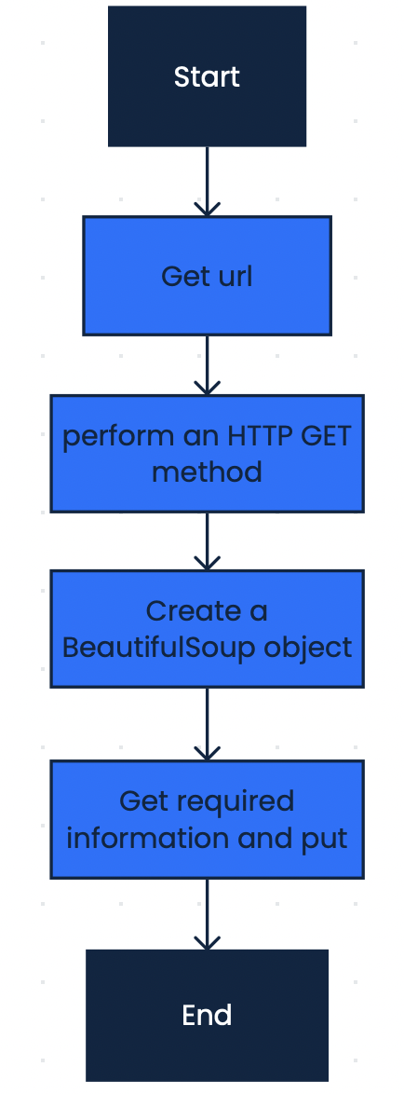
Data Collection - Scraping
Present your web scraping process using key phrases and flowcharts
Add the GitHub URL of the completed web scraping notebook, as an external reference and peer-review purpose

Slide 10
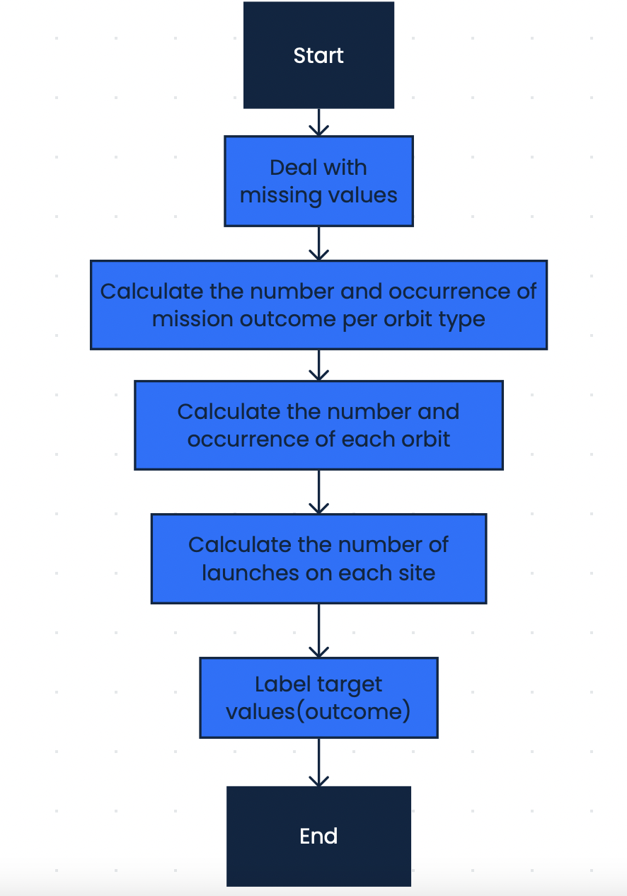
Data Wrangling
Describe how data were processed
Deal with missing values, label target values
You need to present your data wrangling process using key phrases and flowcharts
Add the GitHub URL of your completed data wrangling related notebooks, as an external reference and peer-review purpose

Slide 11
EDA with Data Visualization
Summarize what charts were plotted and why you used those charts
Scatter point chart: we can observe and show relationships between two numeric variables. We can identify correlational relationships using this kind of chart.
Bar chart: This chart can show each data category in a frequency distribution, display relative numbers or proportions of multiple categories, and summarize a large data set in visual form.
Add the GitHub URL of your completed EDA with data visualization notebook, as an external reference and peer-review purpose

Slide 12
EDA with SQL
Using bullet point format, summarize the SQL queries you performed
%sql select distinct LAUNCH_SITE from SPACE1
%sql select * from SPACE1 where LAUNCH_SITE LIKE 'CCA%' LIMIT 5;
%sql select sum(PAYLOAD_MASS__KG_) from SPACE1 where customer='NASA (CRS)’;
%sql select avg(PAYLOAD_MASS__KG_) from SPACE1 where booster_version LIKE 'F9 v1.1’;
%sql select DATE from SPACE1 where LANDING__OUTCOME='Success (ground pad)' LIMIT 1;
%sql select BOOSTER_VERSION from SPACE1 where LANDING__OUTCOME='Success (drone ship)' and PAYLOAD_MASS__KG_ > 4000 and PAYLOAD_MASS__KG_ < 6000;
%sql select count(case when LANDING__OUTCOME LIKE 'Success%' then 1 else null end) as success, count(case when LANDING__OUTCOME LIKE 'Failure%' then 1 else null end) as failure from SPACE1;
%sql select booster_version from space1 where PAYLOAD_MASS__KG_ >= (select max(PAYLOAD_MASS__KG_) from space1);
%sql select landing__outcome, booster_version, launch_site from space1 where date like '%2015' and landing__outcome = 'Failure (drone ship)’;
%sql select count(*) as total, landing__outcome from space1 where date between '04/06/2010' and '20/03/2017' group by landing__outcome order by total desc
Add the GitHub URL of your completed EDA with SQL notebook, as an external reference and peer-review purpose

Slide 13
Build an Interactive Map with Folium
Summarize what map objects such as markers, circles, lines, etc. you created and added to a folium map
Explain why you added those objects
Add the GitHub URL of your completed interactive map with Folium map, as an external reference and peer-review purpose
Markers: present data on a map
Circles: show the range of the city
Lines: show the distance between two position

Slide 14
Build a Dashboard with Plotly Dash
Summarize what plots/graphs and interactions you have added to a dashboard
Explain why you added those plots and interactions
Add the GitHub URL of your completed Plotly Dash lab, as an external reference and peer-review purpose
Pie Chart: display relative proportions of multiple classes of data.
Scatter Point Plot: allow you to compare two seemingly unrelated variables and determine the relationship between them.

Slide 15
Predictive Analysis (Classification)
Summarize how you built, evaluated, improved, and found the best performing classification model
You need present your model development process using key phrases and flowchart
Add the GitHub URL of your completed predictive analysis lab, as an external reference and peer-review purpose
I standardized data and split data into train set and test set. I set some possible values for every parameters. I created grid search object and classification model. The grid search object can help me find the best parameter for that model. Then I calculate accuracy on each model and compare them to find the best model.

Slide 16
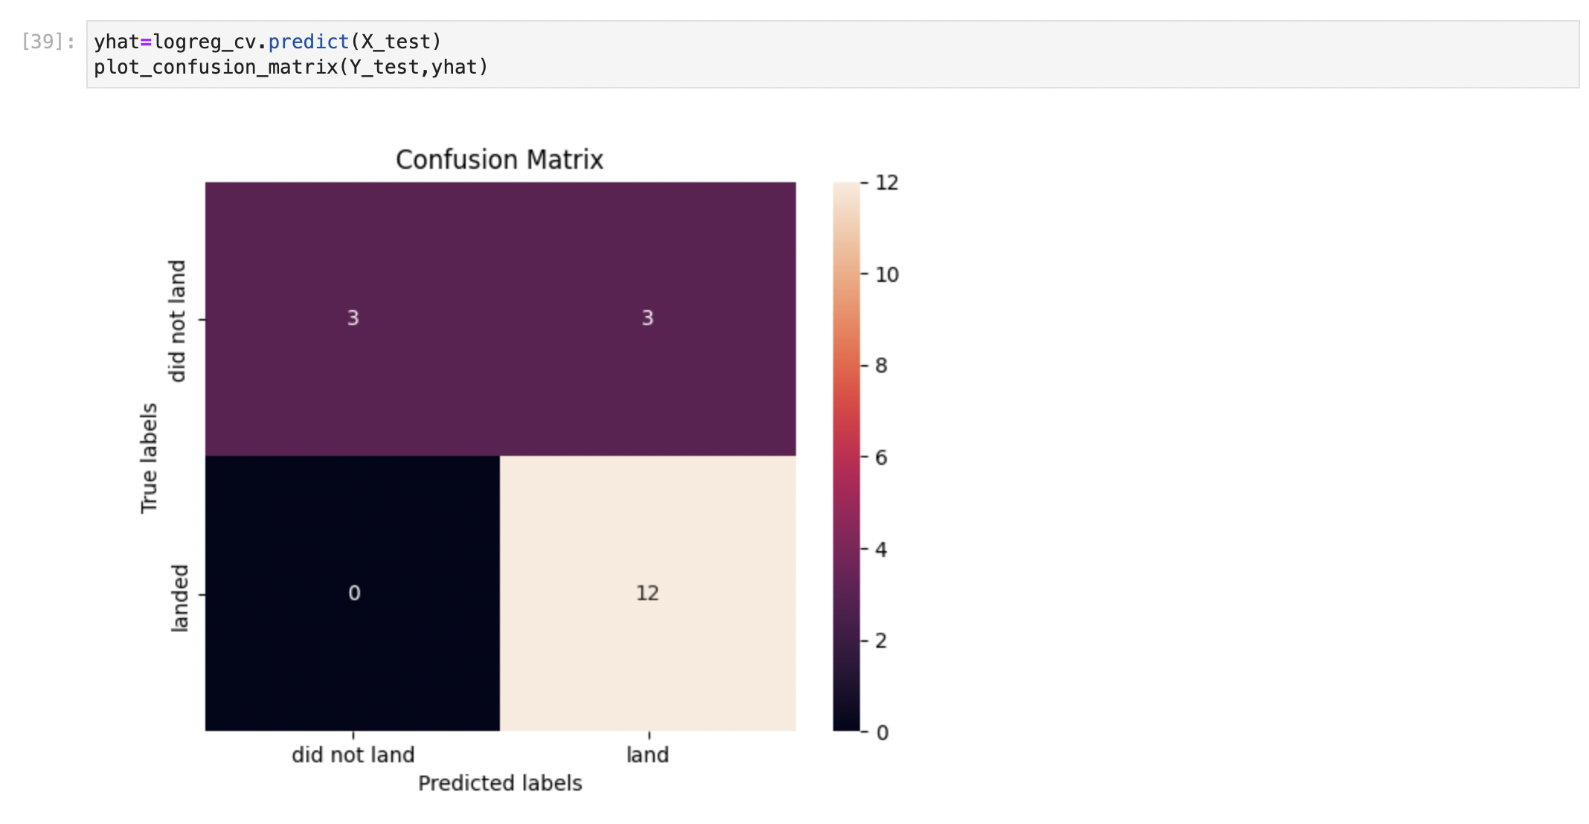
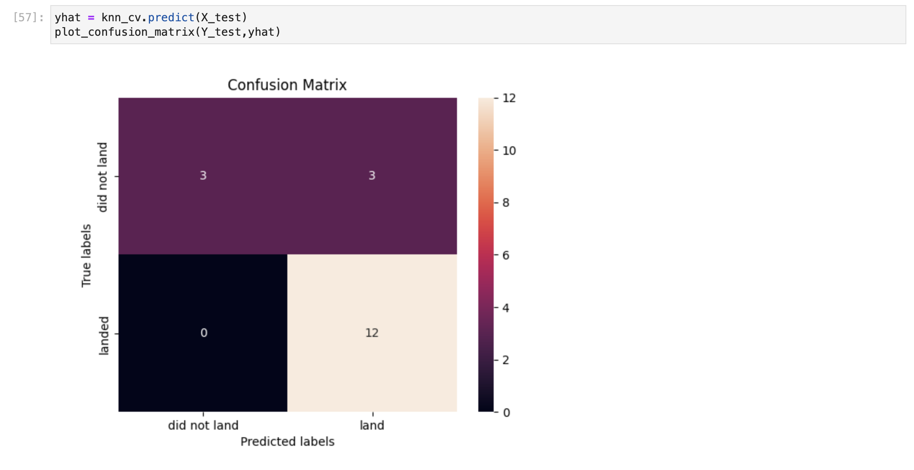
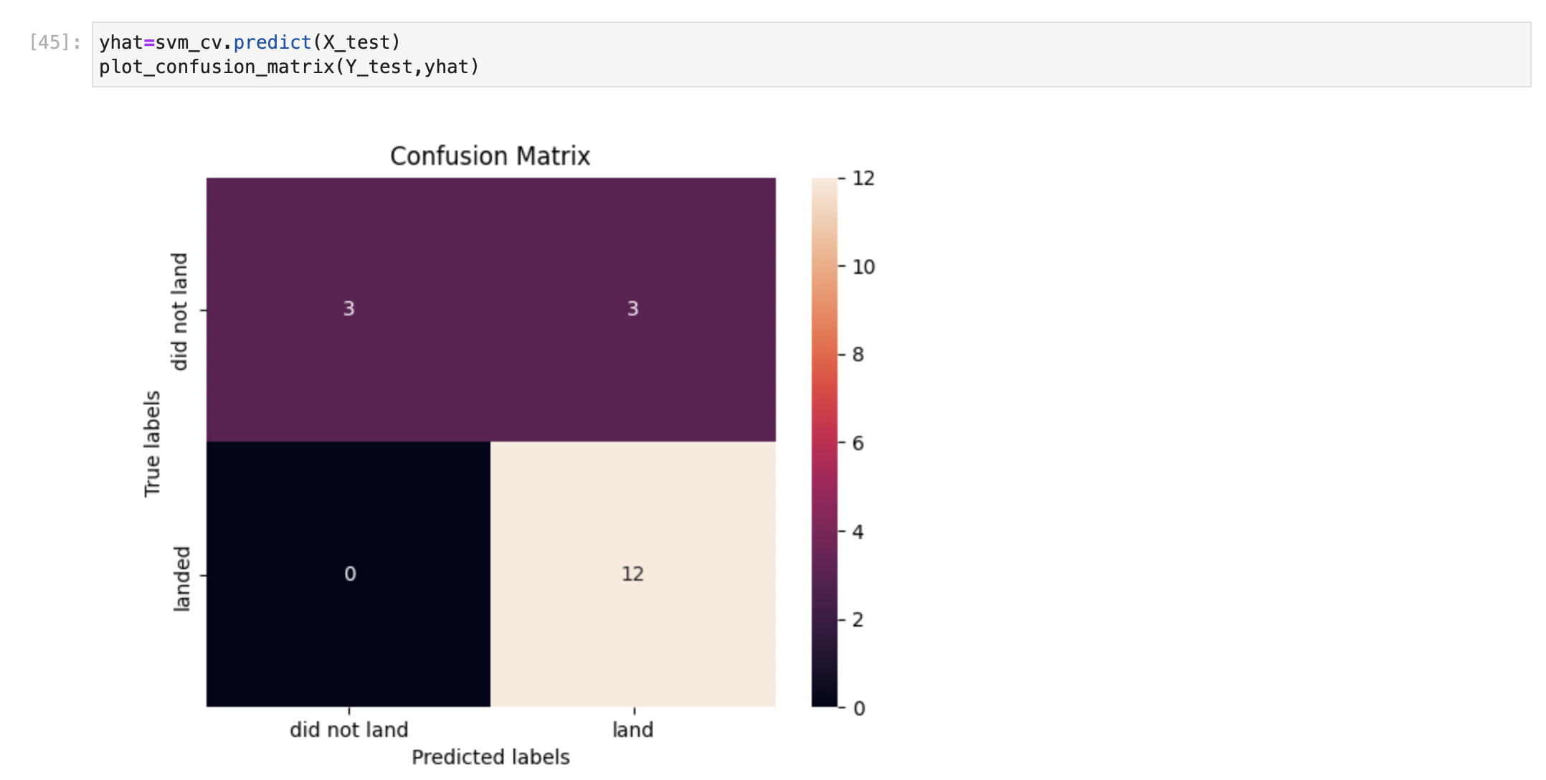
Results
Exploratory data analysis results
Interactive analytics demo in screenshots
Predictive analysis results
I have trained three models: logistic regression, svm and knn.

Slide 17

Section 2

Slide 18
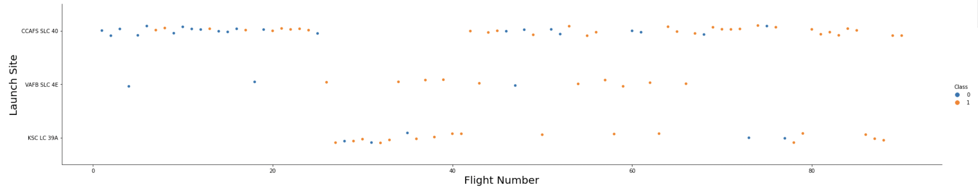
Flight Number vs. Launch Site
Show a scatter plot of Flight Number vs. Launch Site
Show the screenshot of the scatter plot with explanations
Most Flight launch at CCAFS SLC 40. CCAFS SLC 40 is a famous launch site. Many unsuccessful flights launch at CCAFS SLC 40.

Slide 19
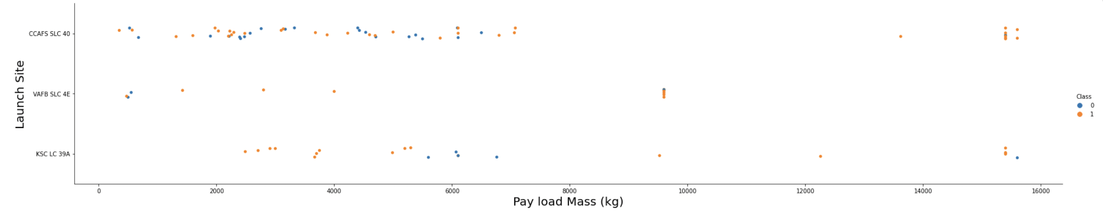
Payload vs. Launch Site
Show a scatter plot of Payload vs. Launch Site
Show the screenshot of the scatter plot with explanations
Most flights have less than 8000 pay load mass. Most flights launch at CCAPFS SLC 40.

Slide 20
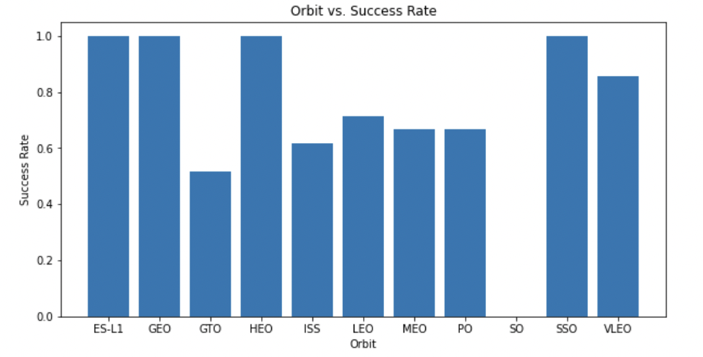
Success Rate vs. Orbit Type
Show a bar chart for the success rate of each orbit type
Show the screenshot of the scatter plot with explanations
ES-L1, GEO, HEO and SSO have the highest success rate, 100%, while GTO has the lowest success rage, around 50%.

Slide 21
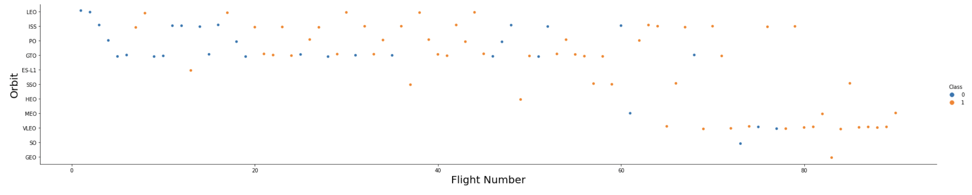
Flight Number vs. Orbit Type
Show a scatter point of Flight number vs. Orbit type
Show the screenshot of the scatter plot with explanations
Most flights are in LEO, ISS, PO and GTO. Early flights are always unsuccessful.

Slide 22
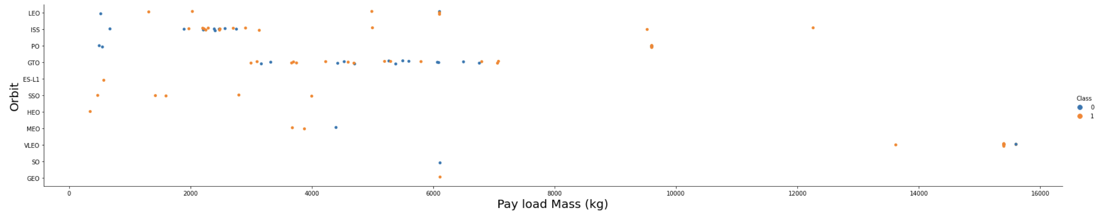
Payload vs. Orbit Type
Show a scatter point of payload vs. orbit type
Show the screenshot of the scatter plot with explanations
Most flights are less than 8000 pay load mass(kg). Most flights are in GTO and ISS orbit. Most unsucessful flights have light weight.

Slide 23
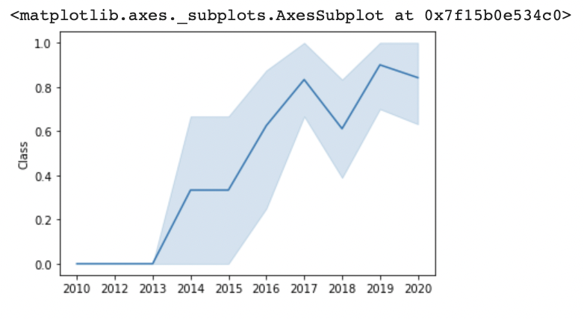
Launch Success Yearly Trend
Show a line chart of yearly average success rate
Show the screenshot of the scatter plot with explanations
Compared with 2010, the success rate have significant improvement in 2020.

Slide 24
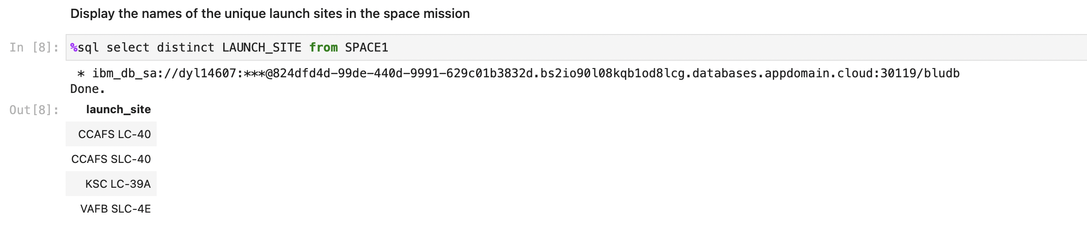
All Launch Site Names
Find the names of the unique launch sites
Present your query result with a short explanation here

Slide 25
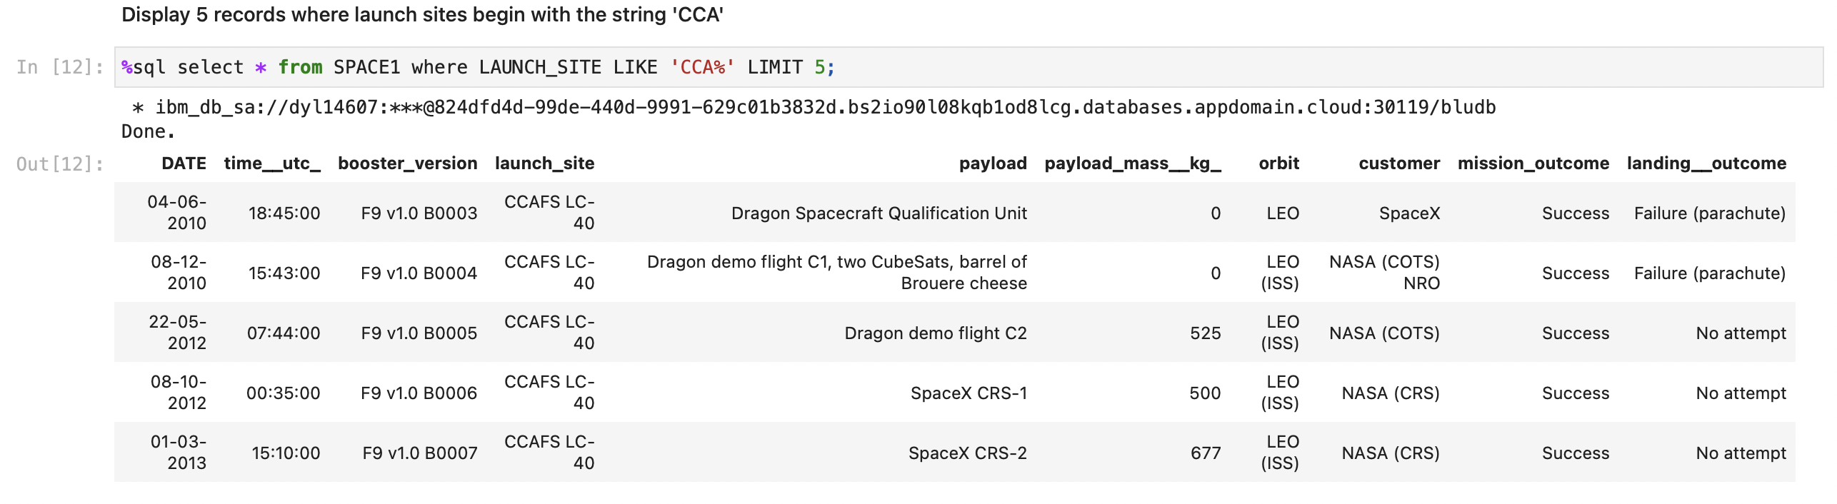
Launch Site Names Begin with 'CCA'
Find 5 records where launch sites begin with `CCA`
Present your query result with a short explanation here

Slide 26
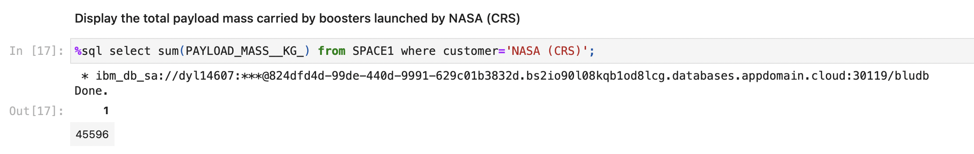
Total Payload Mass
Calculate the total payload carried by boosters from NASA
Present your query result with a short explanation here

Slide 27
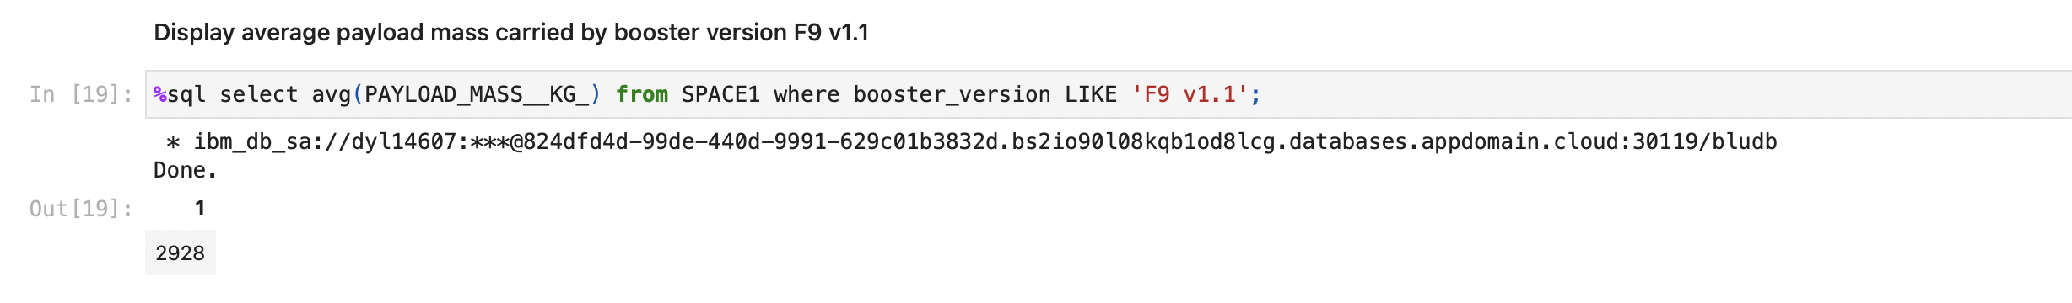
Average Payload Mass by F9 v1.1
Calculate the average payload mass carried by booster version F9 v1.1
Present your query result with a short explanation here

Slide 28
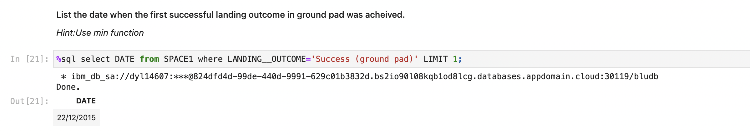
First Successful Ground Landing Date
Find the dates of the first successful landing outcome on ground pad
Present your query result with a short explanation here

Slide 29
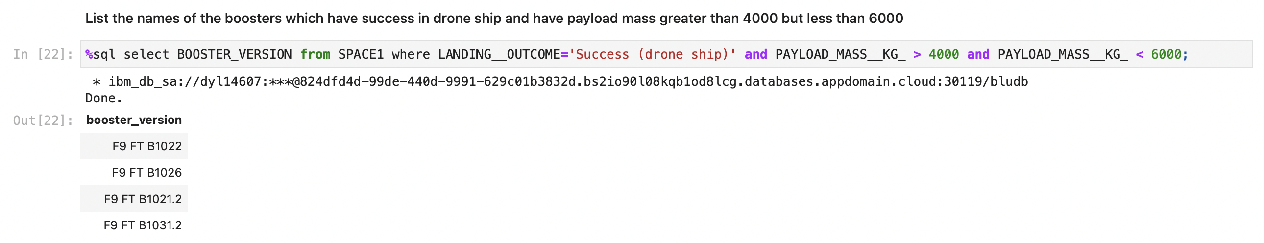
Successful Drone Ship Landing with Payload between 4000 and 6000
List the names of boosters which have successfully landed on drone ship and had payload mass greater than 4000 but less than 6000
Present your query result with a short explanation here

Slide 30
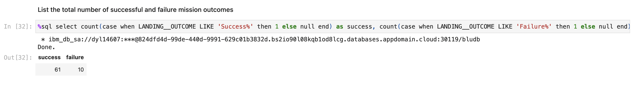
Total Number of Successful and Failure Mission Outcomes
Calculate the total number of successful and failure mission outcomes
Present your query result with a short explanation here

Slide 31
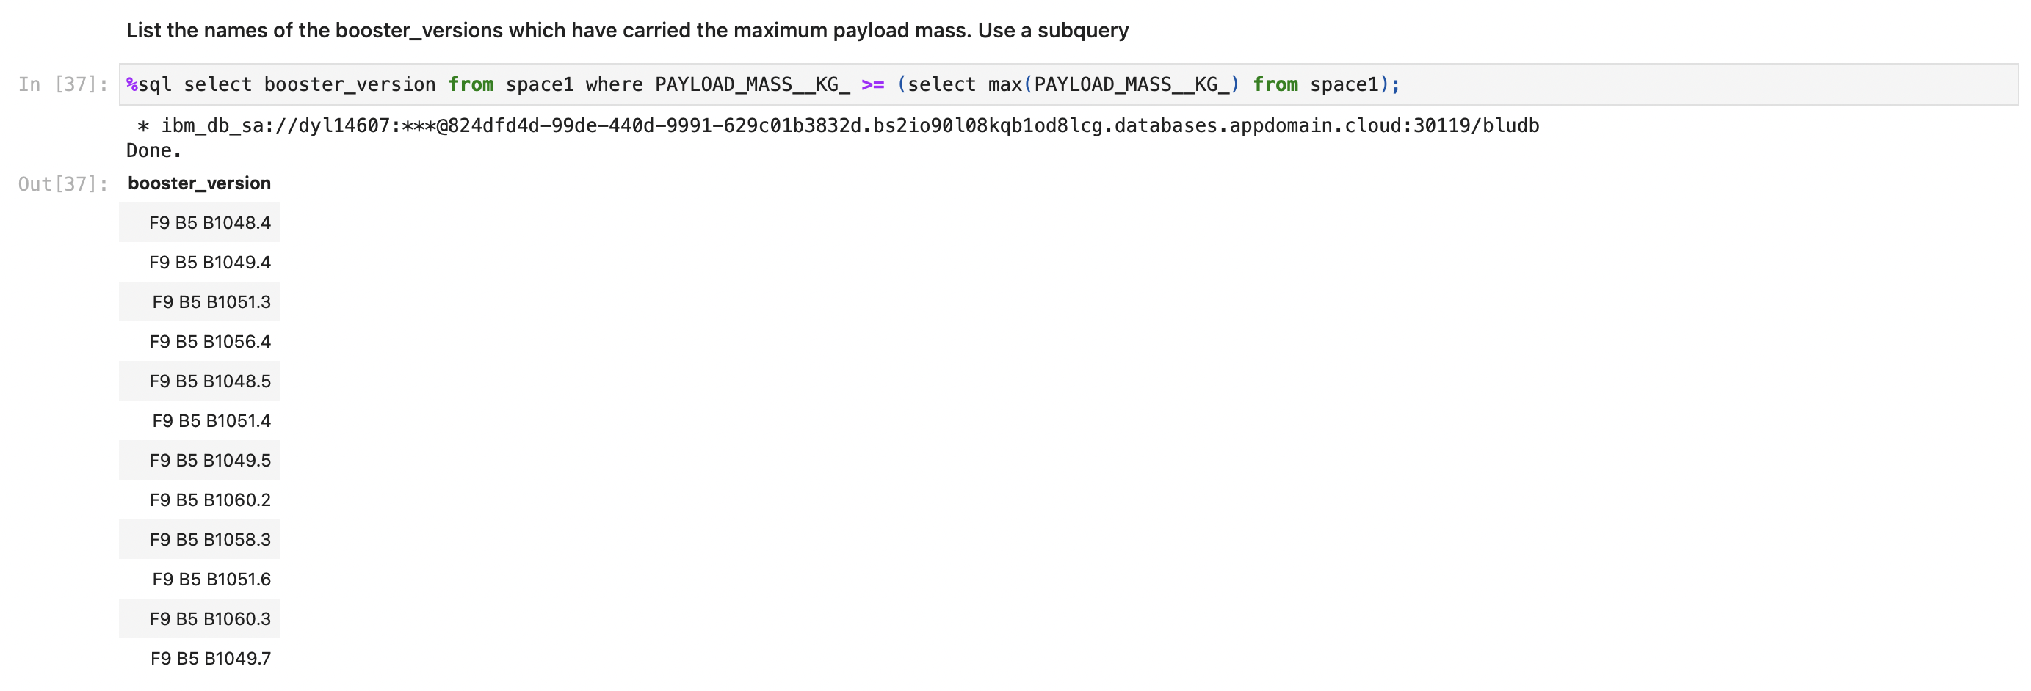
Boosters Carried Maximum Payload
List the names of the booster which have carried the maximum payload mass
Present your query result with a short explanation here

Slide 32
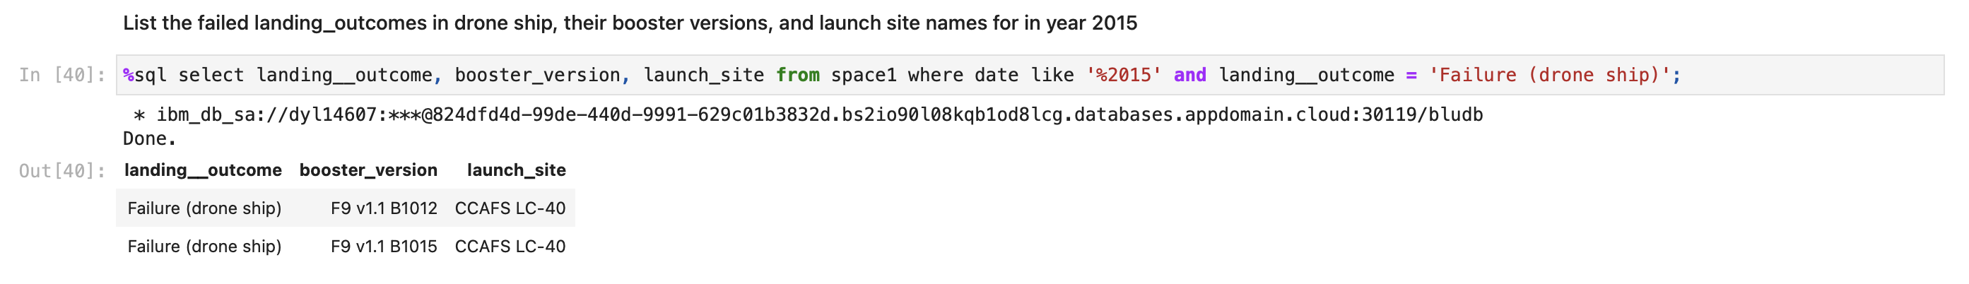
2015 Launch Records
List the failed landing_outcomes in drone ship, their booster versions, and launch site names for in year 2015
Present your query result with a short explanation here

Slide 33
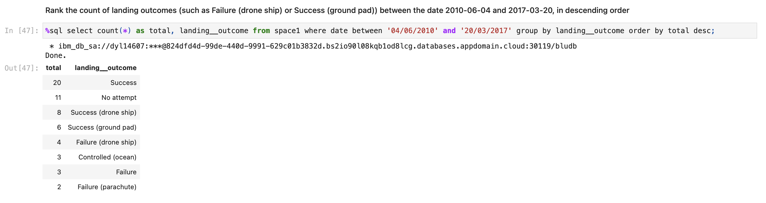
Rank Landing Outcomes Between 2010-06-04 and 2017-03-20
Rank the count of landing outcomes (such as Failure (drone ship) or Success (ground pad)) between the date 2010-06-04 and 2017-03-20, in descending order
Present your query result with a short explanation here

Slide 34

Section 4

Slide 35
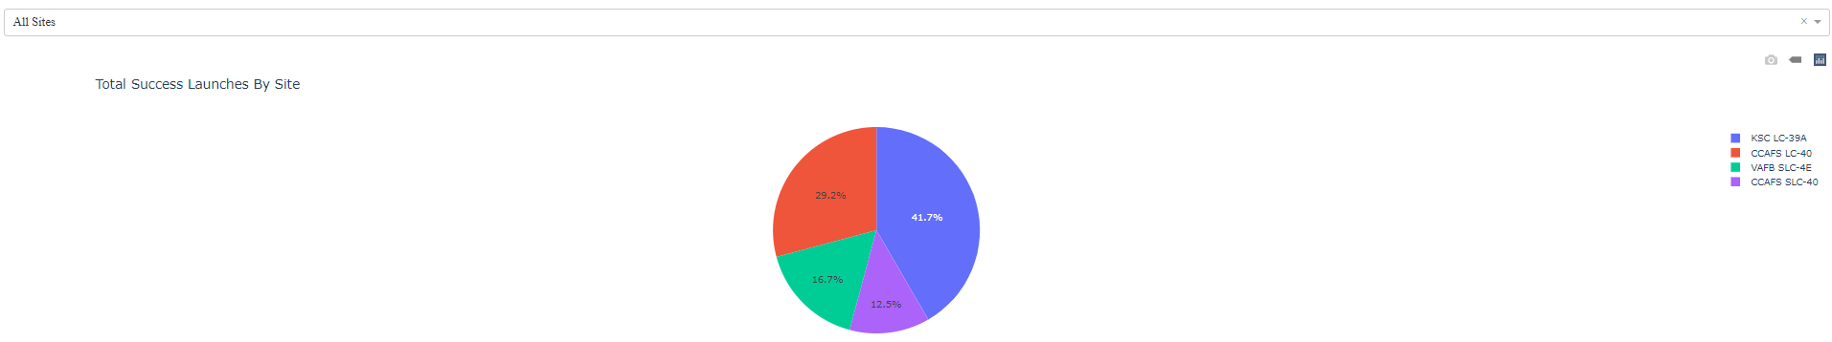
Launch success for all sites
Show the screenshot of launch success count for all sites, in a piechart
Explain the important elements and findings on the screenshot
KSC LC-39A has the highest launch success, while CCAFS SLC-40 has the lowest launch success.

Slide 36
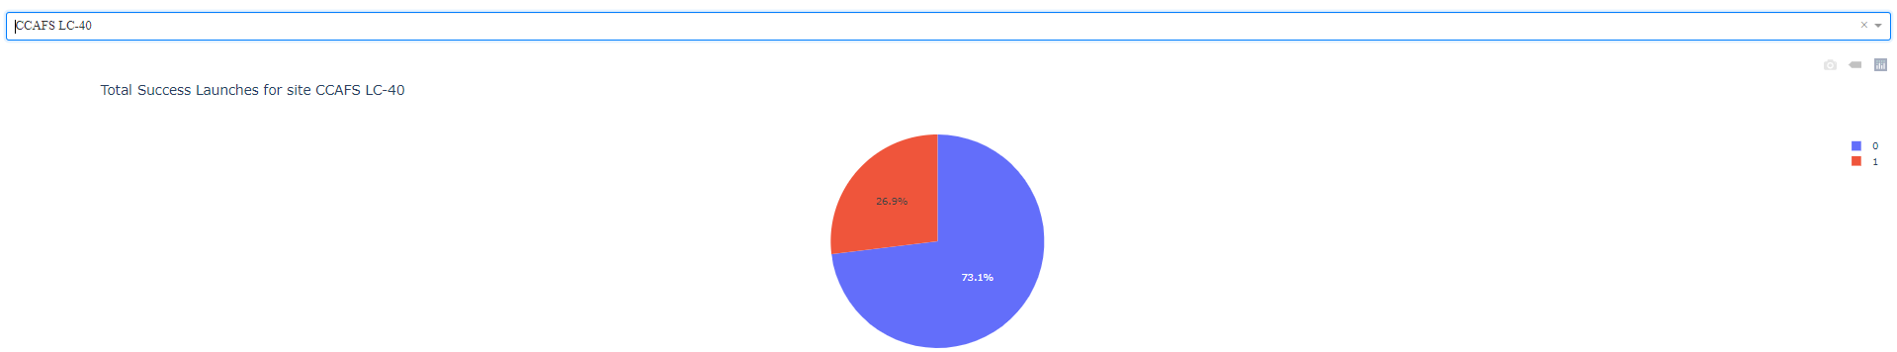
CCAFS LC-40
Show the screenshot of the piechart for the launch site with highest launch success ratio
Explain the important elements and findings on the screenshot
CCAFS LC-40 has 26.9% success rate.

Slide 37
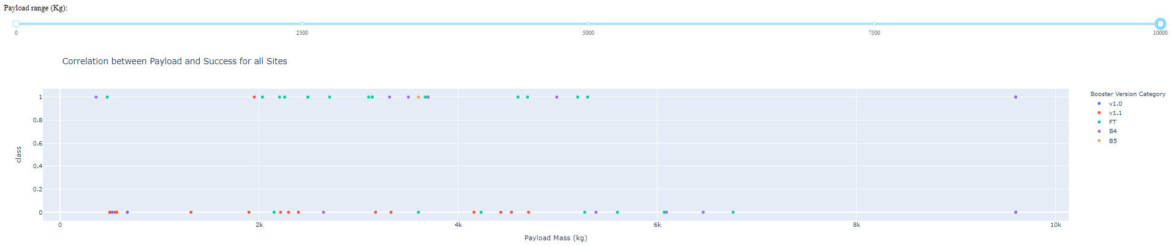
Payload vs. Launch Outcomes
Show screenshots of Payload vs. Launch Outcome scatter plot for all sites, with different payload selected in the range slider
Explain the important elements and findings on the screenshot, such as which payload range or booster version have the largest success rate, etc.
Most FT have the highest success outcome, while most v1.1 has the unsuccessful outcome.

Slide 38

Section 5

Slide 39
Classification Accuracy
Visualize the built model accuracy for all built classification models, in a bar chart
Find which model has the highest classification accuracy
Logistic Regression has the highest accuracy.

Slide 40
Confusion Matrix
Show the confusion matrix of the best performing model with an explanation
The model has a perfect performance on checking the land rate.

Slide 41
Conclusions
Logistic Regression Model can have a good performance on predicting whether the flight can land.
Most Flight launch at CCAFS SLC 40. CCAFS SLC 40 is a famous launch site. Many not successful flights launch at CCAFS SLC 40.
Most flights have less than 8000 pay load mass. Most flights launch at CCAPFS SLC 40.
ES-L1, GEO, HEO and SSO have the highest success rate, 100%, while GTO has the lowest success rage, around 50%.
Most flights are in LEO, ISS, PO and GTO. Early flights are always unsuccessful.

Slide 42
Appendix
Include any relevant assets like Python code snippets, SQL queries, charts, Notebook outputs, or data sets that you may have created during this project

Slide 43


